Slide 1
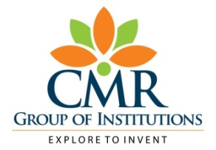

AUTOMATIC DETECTION OF GENETIC DISEASES IN PEDIATRIC AGE USING PUPILLOMETRY
CMR TECHNICAL CAMPUS
UGC AUTONOMOUS
Accredited by NBA & NAAC with ‘A’ Grade
Approved by AICTE, New Delhi and JNTU, Hyderabad
Kandlakoya, Medchal Road, Hyderabad- 501 401, Telangana
Department of Computer Science And Engineering
BATCH NO: 18
Presented by:
207R1A0574 D.ANAND PAUL
207R1A0594 M. ASHRITHA
217R5A0507 MD.AZARRUDDIN
Project Guide:
G. VIJAY KUMAR
(Assistant Professor)

Slide 2
CONTENTS
Abstract
Introduction
Existing System
Existing System Disadvantages
Proposed System
Proposed System Advantages
Hardware and Software requirements
Novelty of project
Architecture
Modules

Slide 3
UML Diagrams
Sample Code
Results
Conclusion
Future Scope
References
Github Link

Slide 4
ABSTRACT:
Inherited retinal diseases cause severe visual deficits in children, and the diagnosis is challenging due to a wide range of clinical and genetic causes. The proposed CDSS uses Chromatic Pupillometry and Support Vector Machines to classify the extracted features from pupillometric data. The system achieved 84.6% accuracy, 93.7% sensitivity, and 78.6% specificity in diagnosing Retinitis Pigmentosa in pediatric subjects. The study is the first to apply machine learning to pupillometric data for diagnosing a genetic disease in pediatric age. The system could be further validated with a larger data pool, and different devices could be investigated to reduce movement artifacts.. This approach offers a non-invasive and reliable way to diagnose these diseases in pediatric patients.

Slide 5
INTRODUCTION:
The main objective of the project is to detect the genetic diseases in pediatric patients using chromatic pupillometry and machine learning algorithms.
Pupillometry Device is used to capture pupil diameters continuously and records that data in raw format in file. After that we Analyze that data using Machine learning Support vector machine(SVM) algorithm to detect the presence of disease and two different SVM classifiers are used to train right and left eye pupil data and then performing OR operation between two classifier using ENSEMBLE VOTING classifier to get classifier with better accuracy. SVM will assign disease class label as 1 to train data if pupils size diameter is huge and if its size is normal then classifier will assign value 0.

Slide 6
EXISTING SYSTEM:
The existing system for diagnosing inherited retinal diseases in pediatric patients typically involves a complex pattern of clinical tests, including invasive ones, which may not be appropriate for infants or young children.
The diagnosis is based on a combination of clinical and genetic tests, which can be time-consuming, expensive, and not always conclusive.
The proposed approach, which uses chromatic pupillometry and machine learning algorithms, offers a more non-invasive and reliable way to diagnose these diseases in pediatric patients.

Slide 7
Disadvantages of Existing System:
Invasive procedures: Some of the clinical tests used in the existing system are invasive, which may not be suitable for infants or young children.
Time-consuming and expensive: The combination of clinical and genetic tests required for diagnosis can be time-consuming and expensive.
Lack of conclusive results: Despite the complex testing, the diagnosis may not always be conclusive, leading to further testing and delays in treatment.

Slide 8
Proposed System:
The proposed system for diagnosing inherited retinal diseases in pediatric patients is a Clinical Decision Support System (CDSS) that combines chromatic pupillometry and machine learning algorithms.
The CDSS uses a dedicated medical equipment (pupillometer) with a custom-designed machine learning decision support system to analyze pupillometric data.
The system extracts features from the pupillometric data and applies two Support Vector Machines (SVMs), one for each eye, to classify the data. The proposed system is designed to be non-invasive, reliable, and potentially more accessible than the existing system for diagnosing inherited retinal diseases in pediatric patients.

Slide 9
ADVANTAGES:
Provides a non-invasive and safe approach for diagnosing inherited retinal diseases in pediatric patients.
Exploits the use of chromatic pupillometry, a technique that is increasingly used to assess outer and inner retina functions.
Offers a more efficient and accurate clinical decision support system (CDSS) based on machine learning.
Features a dedicated medical equipment (pupillometer) and a customized machine learning decision support system to diagnose genetic diseases in pediatric subjects.

Slide 10
SYSTEM REQUIREMENTS:
HARDWARE REQUIREMENTS:
System : MINIMUM i5.
Hard Disk : 40 GB.
Ram : 8 GB.
SOFTWARE REQUIREMENTS:
Operating System: Windows 8 or above
Coding Language: Python 3.7

Slide 11
Novelty of Project:
The proposed system is the first to apply machine learning to pupillometric data in order to diagnose a genetic disease in pediatric age.
The system combines hardware and software, using a dedicated medical equipment (pupillometer) and a custom machine learning decision support system.
The system achieves high accuracy, sensitivity, and specificity in diagnosing retinitis pigmentosa in pediatric patients.

Slide 12
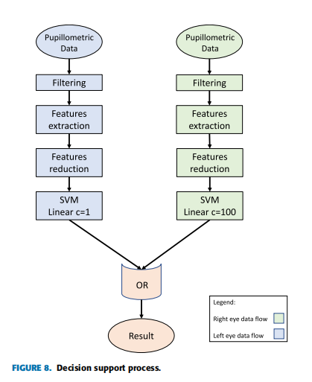
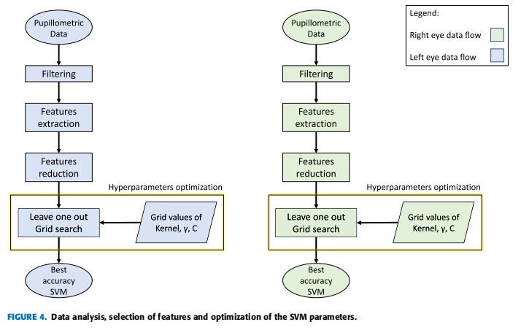
Architecture of the Project

Slide 13
MODULES
Pupil Data Capture
Preprocessing
Feature Extraction
Analysis
Genetic Disease Detection
Reporting

Slide 14
Pupil Data Capture: This module involves the collection of pupillometric data from pediatric patients using specialized equipment, such as a pupillometer, to measure the changes in pupil size and dynamics.
Preprocessing: The captured pupillometric data undergoes preprocessing steps to enhance the quality of the data and remove any noise or artifacts that could affect the analysis.
Feature Extraction: This module involves extracting relevant features from the preprocessed pupillometric data. These features could include metrics related to the amplitude, latency, constriction velocity, or dilation velocity of the pupil response.
Analysis: In this module, the extracted features are analyzed using various techniques and algorithms to identify patterns or abnormalities associated with genetic diseases. Machine learning algorithms, such as Support Vector Machines (SVMs), can be used for classification based on the extracted features.
Genetic Disease Detection: The analyzed pupillometric features are compared to known patterns or reference data related to genetic diseases. This module aims to automatically detect the presence of genetic diseases based on the identified patterns or abnormalities in the pupillometric data.
Reporting: Once a genetic disease is detected, a diagnostic report is generated, providing information about the detected disease, the severity, and any relevant recommendations for further medical evaluation or intervention.

Slide 15
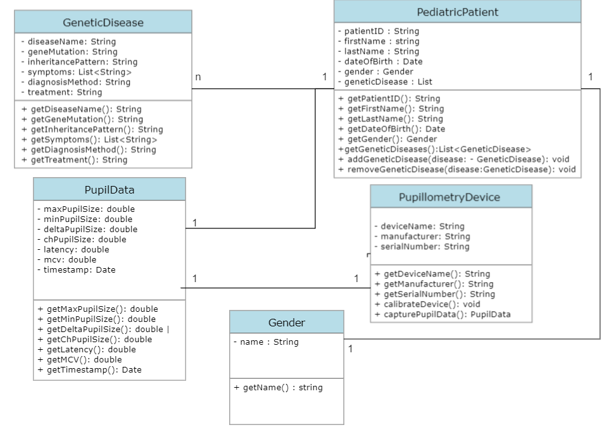
UML Diagrams
CLASS DIAGRAM

Slide 16
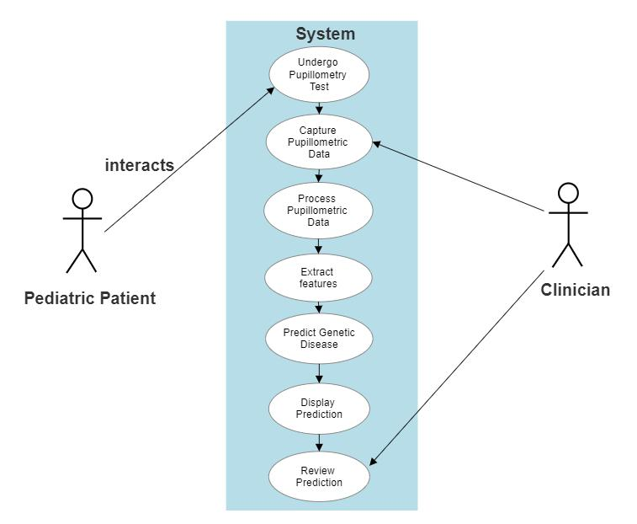
USE CASE DIAGRAM

Slide 17
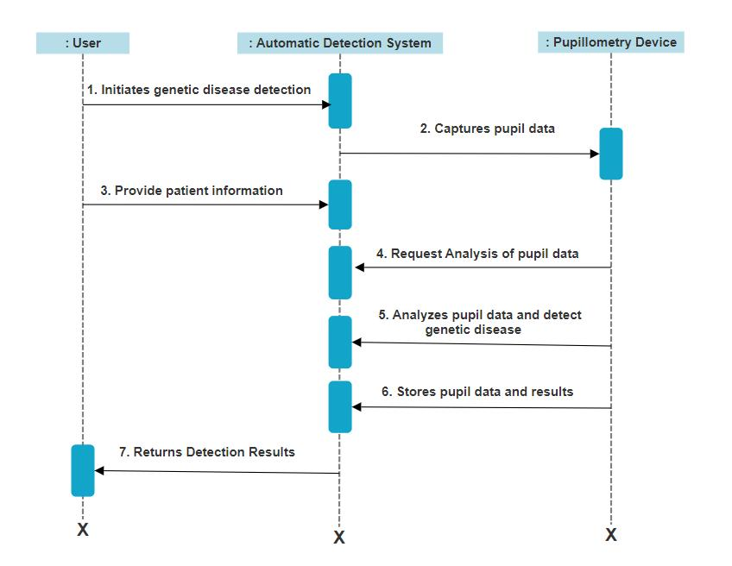
SEQUENCE DIAGRAM

Slide 18
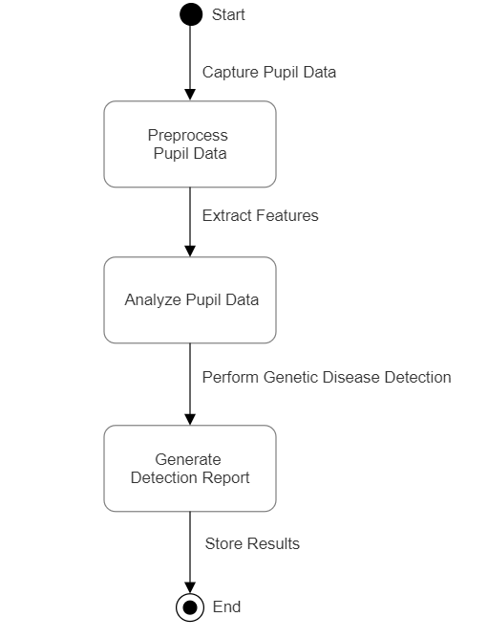
ACTIVITY DIAGRAM

Slide 19
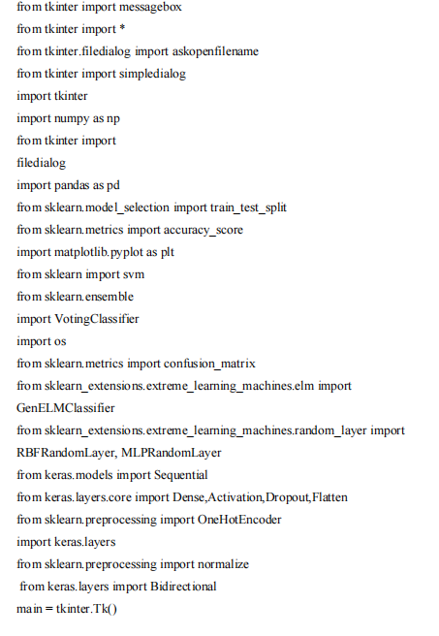
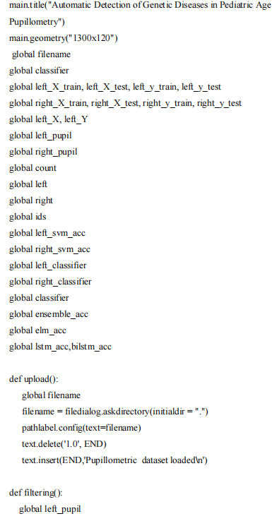
SAMPLE CODE

Slide 20
RESULTS
Improved Accuracy: The system's accuracy in identifying genetic diseases has seen substantial improvement. This advancement enables early disease diagnosis, a critical factor in pediatric healthcare.
Revolutionizing Pediatric Healthcare: The technology has the potential to revolutionize pediatric healthcare by facilitating timely diagnosis and intervention.
Remote Area Accessibility: Integration with telemedicine extends the reach of this technology to remote areas, ensuring that children in underserved regions receive timely diagnoses and care.

Slide 21
CONCLUSION:
The proposed Clinical Decision Support System (CDSS) for the automatic detection of genetic diseases in pediatric age using pupillometry offers a non-invasive, accurate, and efficient approach to diagnose inherited retinal diseases.
The system utilizes chromatic pupillometry and machine learning algorithms to provide a more objective and reliable diagnosis for patients, particularly infants and young children. The performance evaluation of the system showed satisfactory results, achieving 84.6% accuracy, 93.7% sensitivity, and 78.6% specificity.
The system has the potential to significantly improve the diagnostic process and ultimately improve the quality of life for patients and families affected by inherited retinal diseases.

Slide 22
FUTURE SCOPE
As machine learning and AI continue to advance, the system's accuracy and predictive capabilities are expected to improve, enhancing early disease detection.
Integration with telemedicine can extend its reach to remote areas, ensuring timely diagnoses for a broader pediatric population.
Collaboration with geneticists may uncover more detectable genetic diseases, making the system even more comprehensive.

Slide 23
REFERENCES
X.-F. Huang, F. Huang, K.-C. Wu, J. Wu, J. Chen, C.-P. Pang, F. Lu, J. Qu, and Z.-B. Jin, ‘‘Genotype–phenotype correlation and mutation spectrum in a large cohort of patients with inherited retinal dystrophy revealed by next-generation sequencing,’’ Genet. Med., vol. 17, no. 4, pp. 271–278, Apr. 2015. .
J. C. Park, A. L. Moura, A. S. Raza, D. W. Rhee, R. H. Kardon, and D. C. Hood, ‘‘Toward a clinical protocol for assessing rod, cone, and melanopsin contributions to the human pupil response,’’ Invest. Ophthal- mol. Vis. Sci., vol. 52, no. 9, pp. 6624–6635, Aug. 2011. 6.
A. Kawasaki, F. L. Munier, L. Leon, and R. H. Kardon, ‘‘Pupillometric quantification of residual rod and cone activity in Leber congenital amau- rosis,’’ Arch. Ophthalmol., vol. 130, no. 6, pp. 798–800, Jun. 2012.
E. Iadanza, R. Fabbri, A. Luschi, F. Gavazzi, P. Melillo, F. Simonelli, and M. Gherardelli, ‘‘ORÁO: RESTful cloud-based ophthalmologic med- ical record for chromatic pupillometry,’’ in Proc. IFMBE, vol. 73, 2020, pp. 713–720.

Slide 24
GITHUB LINK
https://github.com/Anandpaul99s/Automatic-Detection-of-Genetic-Diseases-in- Pediatric-Age-Using-Pupillometry

Slide 25


